Slide 1
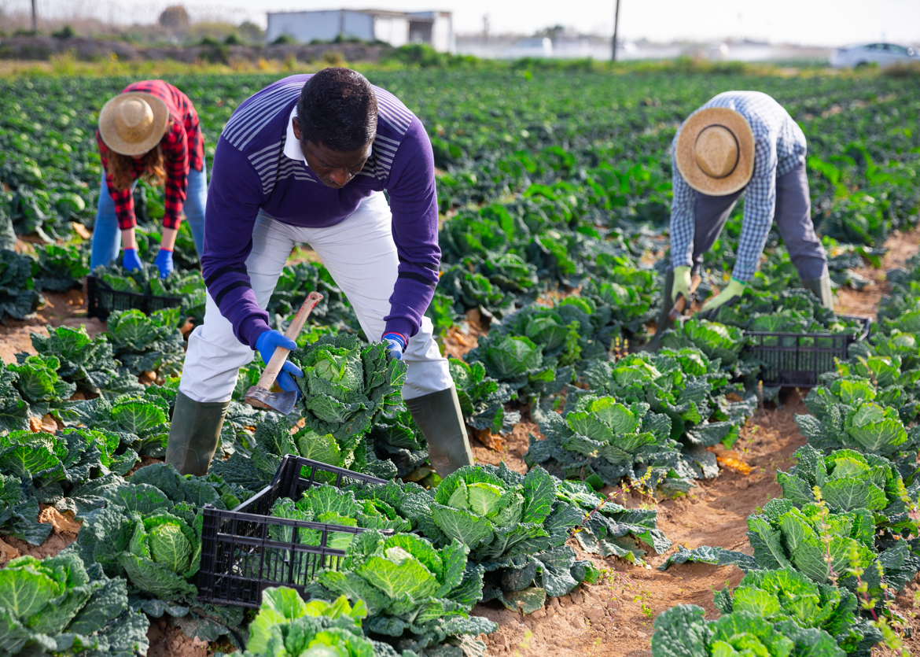
Working with Farms, Fisheries, Forestry and Agribusinesses

Slide 2
Four Training Resources
IDRC has developed a four-part training series that covers each of the four areas of Balanced Recruitment.
Use the resources to review your current efforts and see if there are any additional areas that you can expand your ID&R efforts.

Slide 3
What is Balanced Recruitment?
For MEP programs to be successful it is necessary to ensure that all areas of the state are thoroughly canvassed through Balanced Recruitment Efforts.
This involves covering housing, working to recruit in the community and develop partnerships with community agencies, developing partnerships with farms, fisheries, and agribusinesses as well as working with schools.

Slide 4
What is Balanced Recruitment?
Community Recruitment
Housing
Farms, Fishing, Agribusiness
Schools
All four areas are essential to developing successful Identification and Recruitment Efforts.

Slide 5
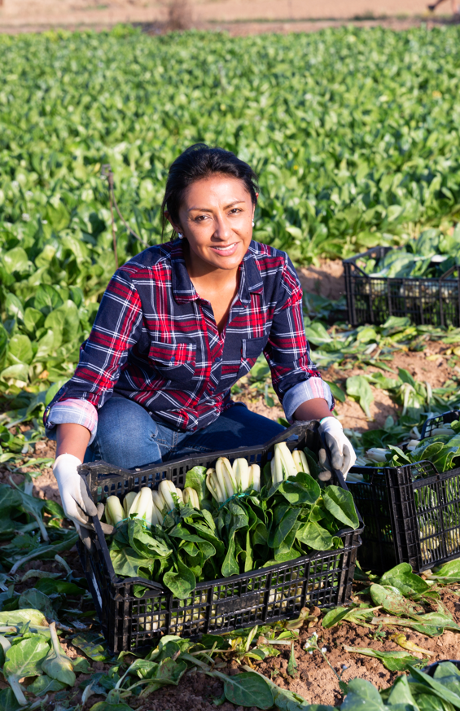
What this training covers…
Visits to farms, fishing, forestry and agricultural businesses at qualifying industries puts us one step closer to eligible students. We will look at:
How to build on your existing list of businesses.
How to prioritize when to visit to successfully identify eligible families and students.

Slide 6
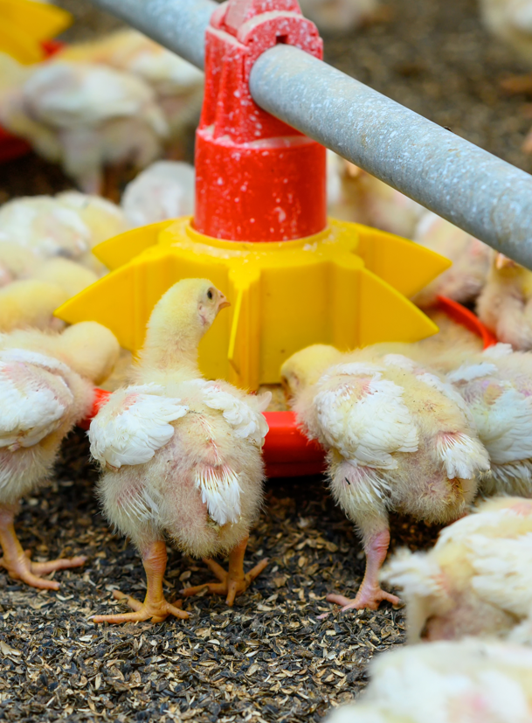
What this training covers…
Working with Agriculture
Once we have a “farm list,” we will develop strategies to:
organize your information
Plan efficient & effective field days
Interview managers & workers
Find other useful tips on the IDRC website

Slide 7
Why Agribusinesses are Important…
When we visit an jobsite, we can identify all the work being performed there, and using the National Regulatory Guidance (NRGs), narrow down the MEP qualifying work.
There is a direct connection between the work, and the people performing it.
A short interview can confirm whether a qualifying move has been made, and set you up for enrolling eligible students.

Slide 8
Finding farms & Agribusinesses: Research
Recruiters should regularly research what is happening in their area in case new farms are constructed and to find the latest news that could affect the agribusinesses in their area. Is a drought negatively impacting crops? Is there an increased demand for hops?
Conversations with owners and workers leads to information about other job sites, housing and places that workers visit.

Slide 9
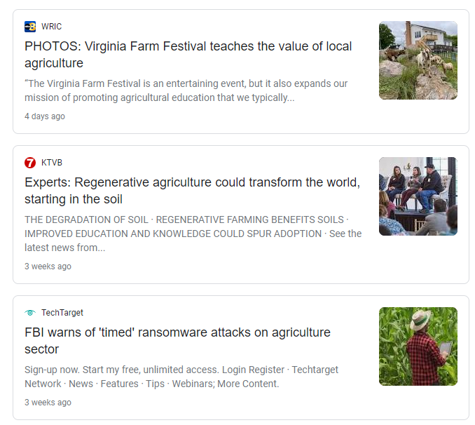
Finding Farms & Agribusinesses: Research
A successful recruiter knows about qualifying agricultural, fishing, forestry and food processing work in their area. They know which businesses outsource and which tend to hire migrant labor, and why. Maybe the work is seasonal, or perhaps there is a lot of turnover that brings people in for short periods of time.
A savvy recruiter stays on top of relevant industry news to help them update and add to their list of business to visit for ID&R.

Slide 10
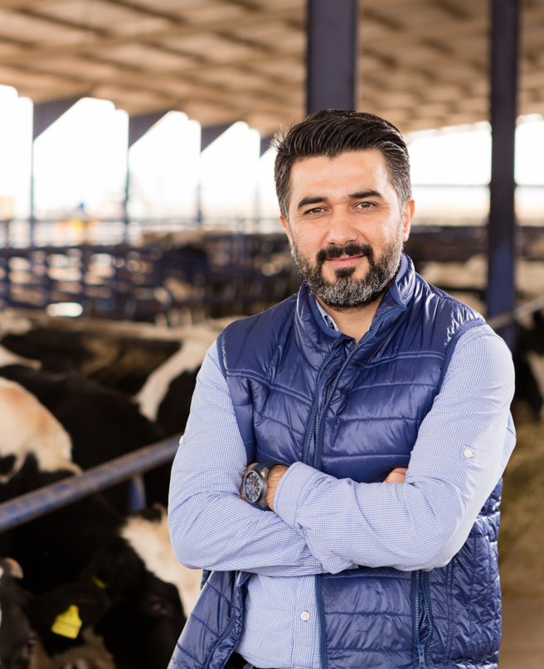
Why Agribusinesses are Important
Talking with owners & managers & workers increases our knowledge about supporting industries that could employ qualifying workers doing qualifying work. Ex.
People at a poultry processing plant can tell you where the birds are being raised.
People in a milk parlor can tell you where cropping and harvesting field work is being done.
People at a sawmill can tell you where logs are coming from, who is logging and where.

Slide 11
Farms & Agribusinesses: Research & Organization
First, find out if your MEP region has an existing list of businesses where successful recruitment has taken place in years past. You can review and update existing data, and add information, and still research and add businesses that are new to you and your program. Some good information to track includes:
Business name & contact information
Include websites and social media accounts with descriptions of the business
Owners or managers & contact information
Address where work is done, and associated housing
Type of industry (dairy, livestock, field crops (fruit, vegetables, feed for livestock or human consumption, ornamentals, etc.), processing plant (meat, fruit, vegetable, etc.), logging, saw mill, maple syrup, orchards, etc.
What type of outsourced labor they have (domestic, H2A, other immigrant labor, etc.) & approximate numbers?
Other information about seasonality, or best times of day/week to visit, who to approach, specific rules for this business

Slide 12
Organize your Data
Add fields to your organizational tool to keep track of your visits.
What date?
Whom did you speak with? Is there another contact you identified?
What did you learn about this business?
Did you enroll anyone in MEP?
Will they be hiring again soon? If so, when should you follow up?

Slide 13
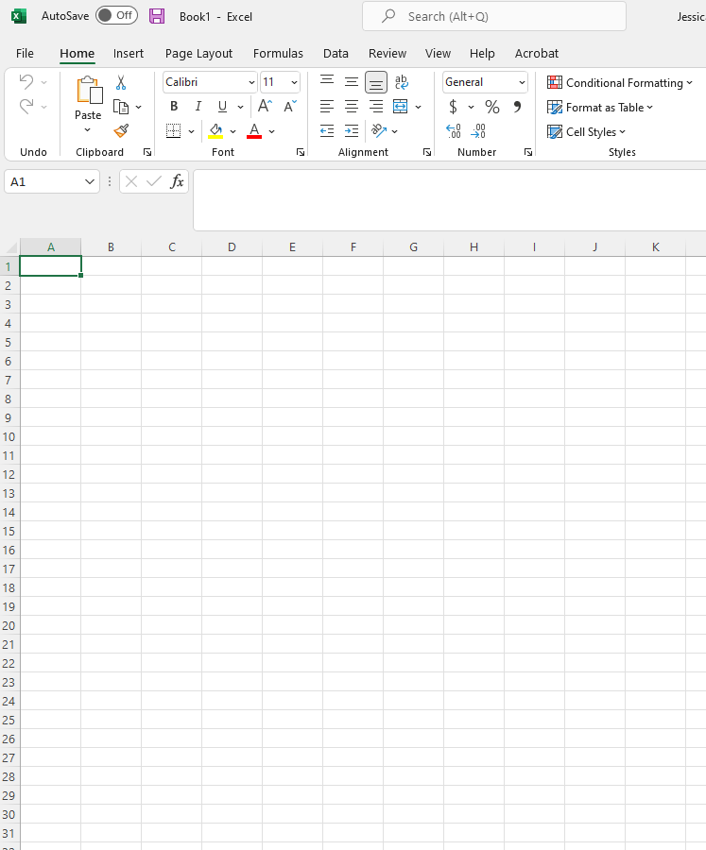
Organize your Data
You can create a spreadsheet using Google Sheets or Microsoft Excel to hold your data and to track what farms you have visited.
Spreadsheets can then be organized by town, or road, date of last visit, or other information that helps you visualize all the work you have done and will let you see when you need to return to a farm.
Farm spreadsheets can also be shared with other recruiters in your area to help share with them all you have learned!

Slide 14
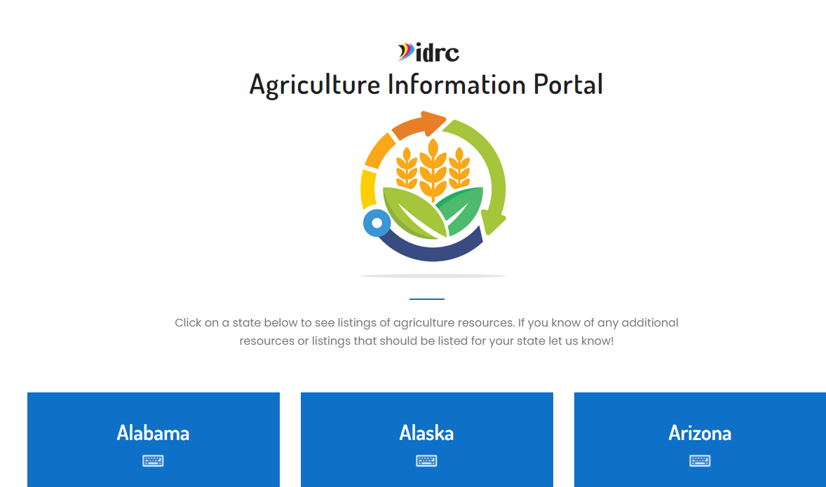
Data to get you started:
IDRC Agriculture Portal

Slide 15
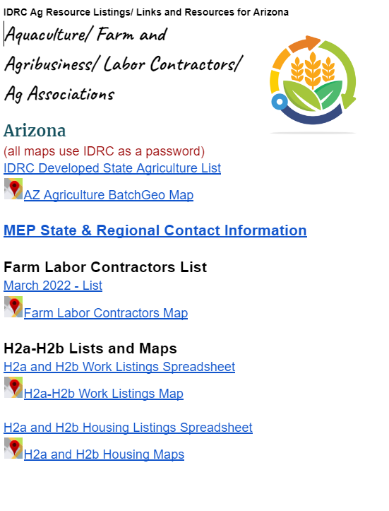
IDRC Agriculture Portal
IDRC Agriculture Lists include information such as:
Farm data taken from Manta.com
Foreign Labor Contractor information
Hemp producers and processors
USDA approved meat, poultry, and egg processors
H2A and H2B requests

Slide 16
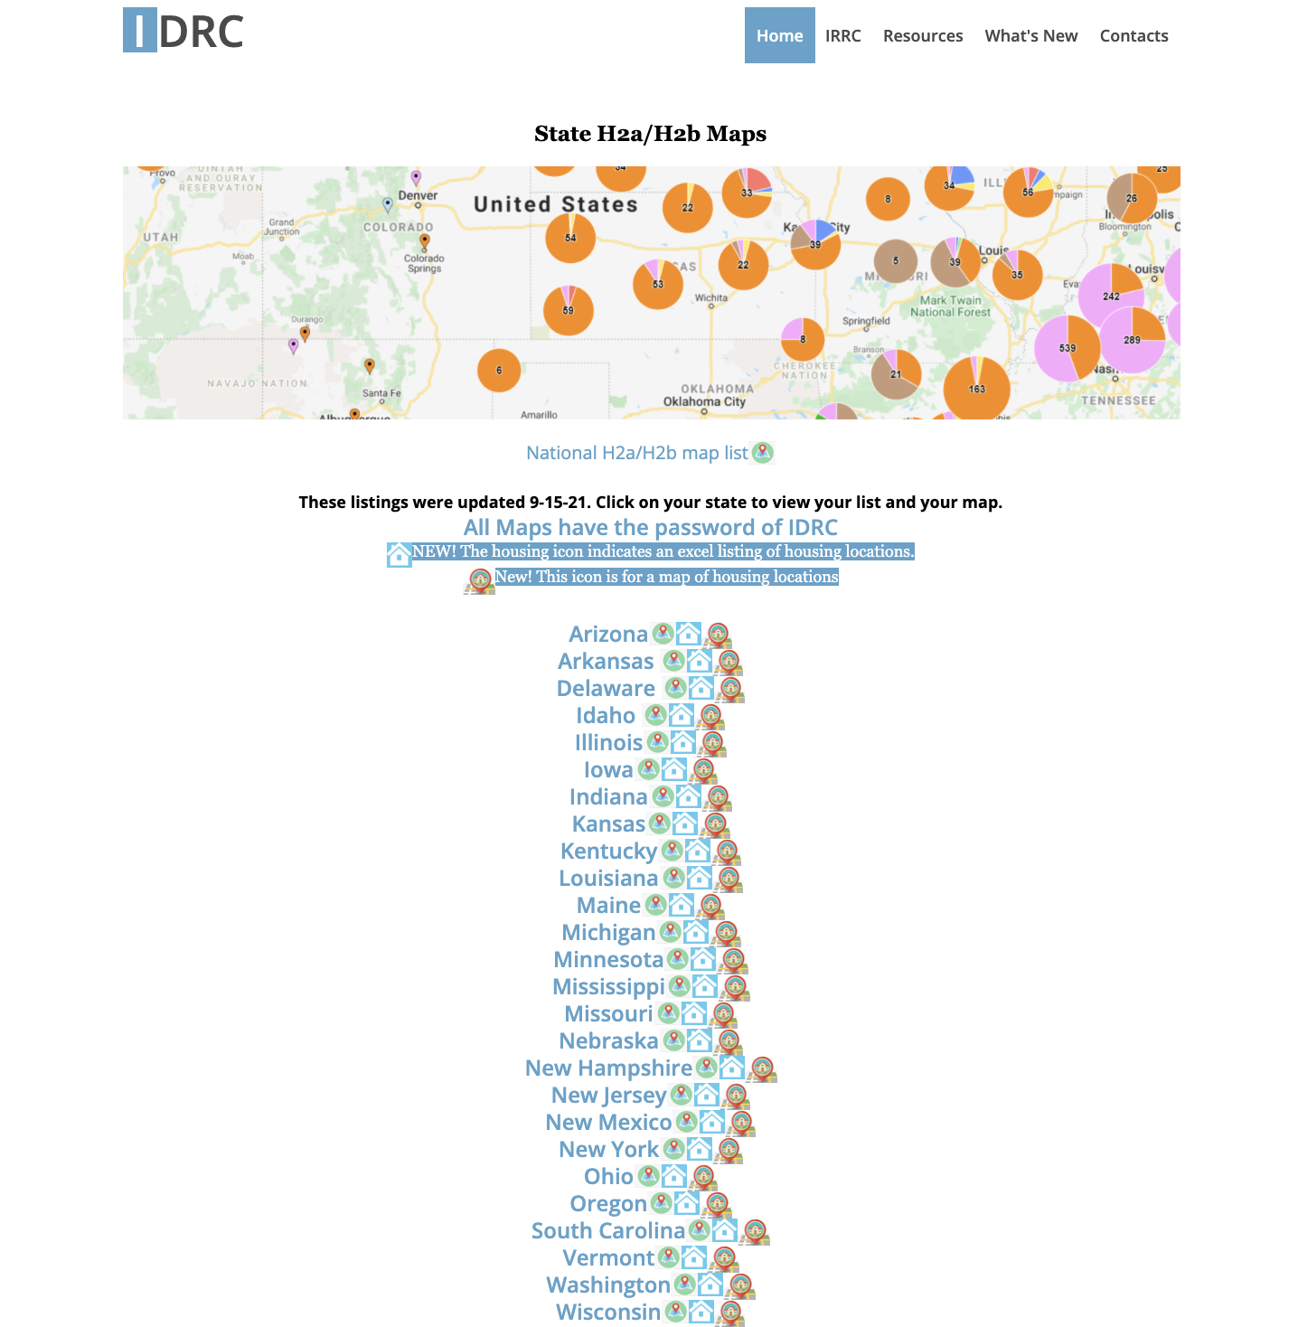
Finding H2A
and H2B
On the IDRC website you can find spreadsheets and maps of the H2A and H2B farms/agribusinesses in your state.
The maps are updated monthly and the spreadsheets are organized to highlight the new farms added each month!
https://www.idr-consortium.net/H2aH2bMaps.html

Slide 17
Google Research
Google is an important tool to let you know the latest agricultural news in your area. Search for
"farm news," "farm worker news," "agricultural news," etc. to learn about what is impacting farms in your area.
Use Google.com/alerts to set up alerts letting you know whenever a new news article about agriculture in your area has been published.

Slide 18
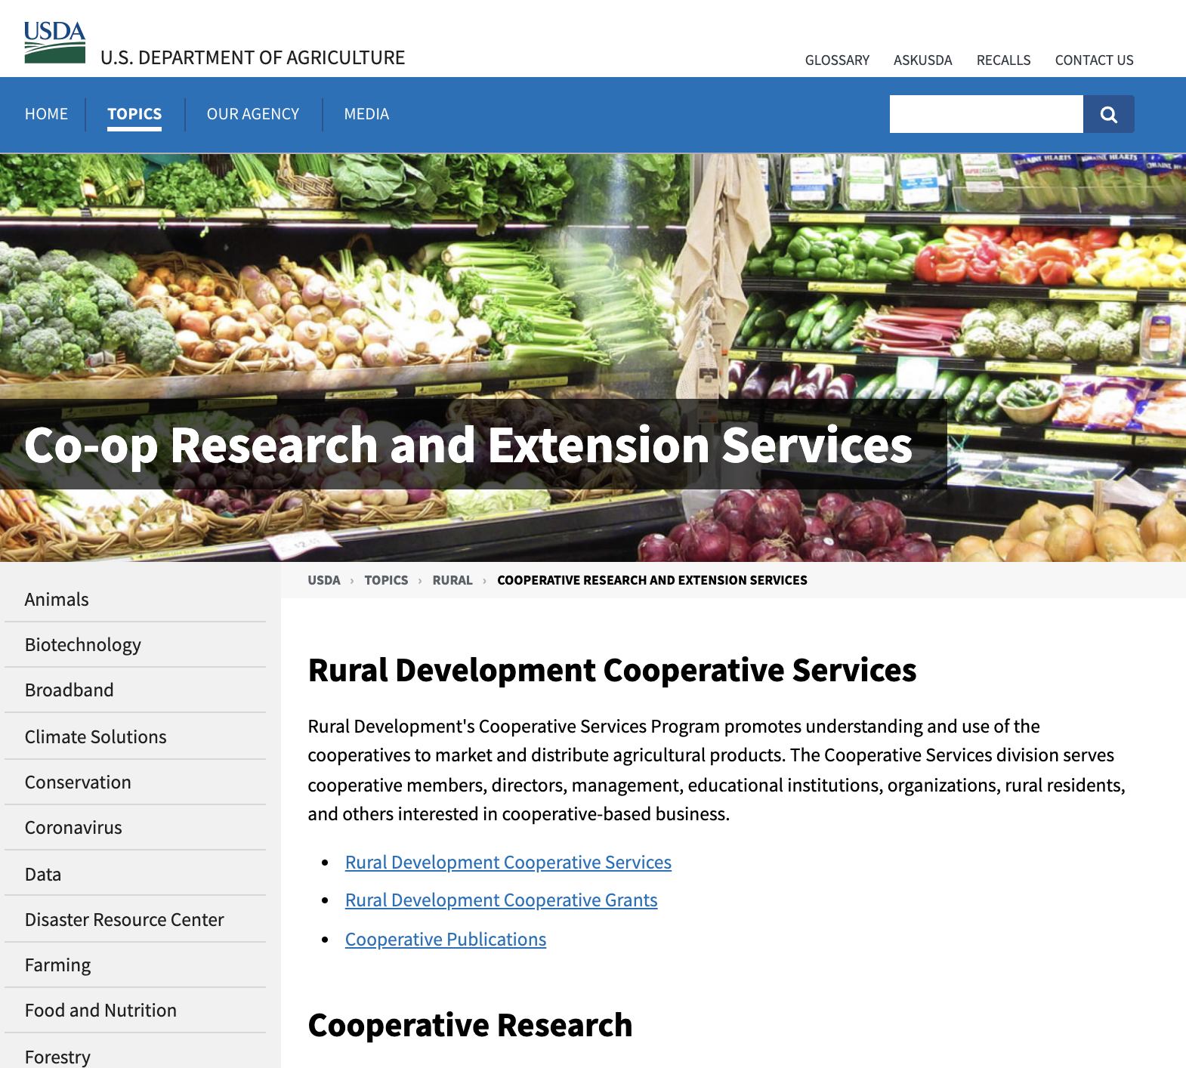
Finding Farms & Agribusiness: Agricultural Extension Offices
USDA Agriculture Extension Offices
The USDA partners with universities in every state to host the Agricultural Extension and Co-op Offices.
The Agricultural Extension offices work to train and educate farmers in the area and to engage the local community. They are great first stops for learning about the agriculture in your area.
https://www.usda.gov/topics/rural/cooperative-research-and-extension-services

Slide 19
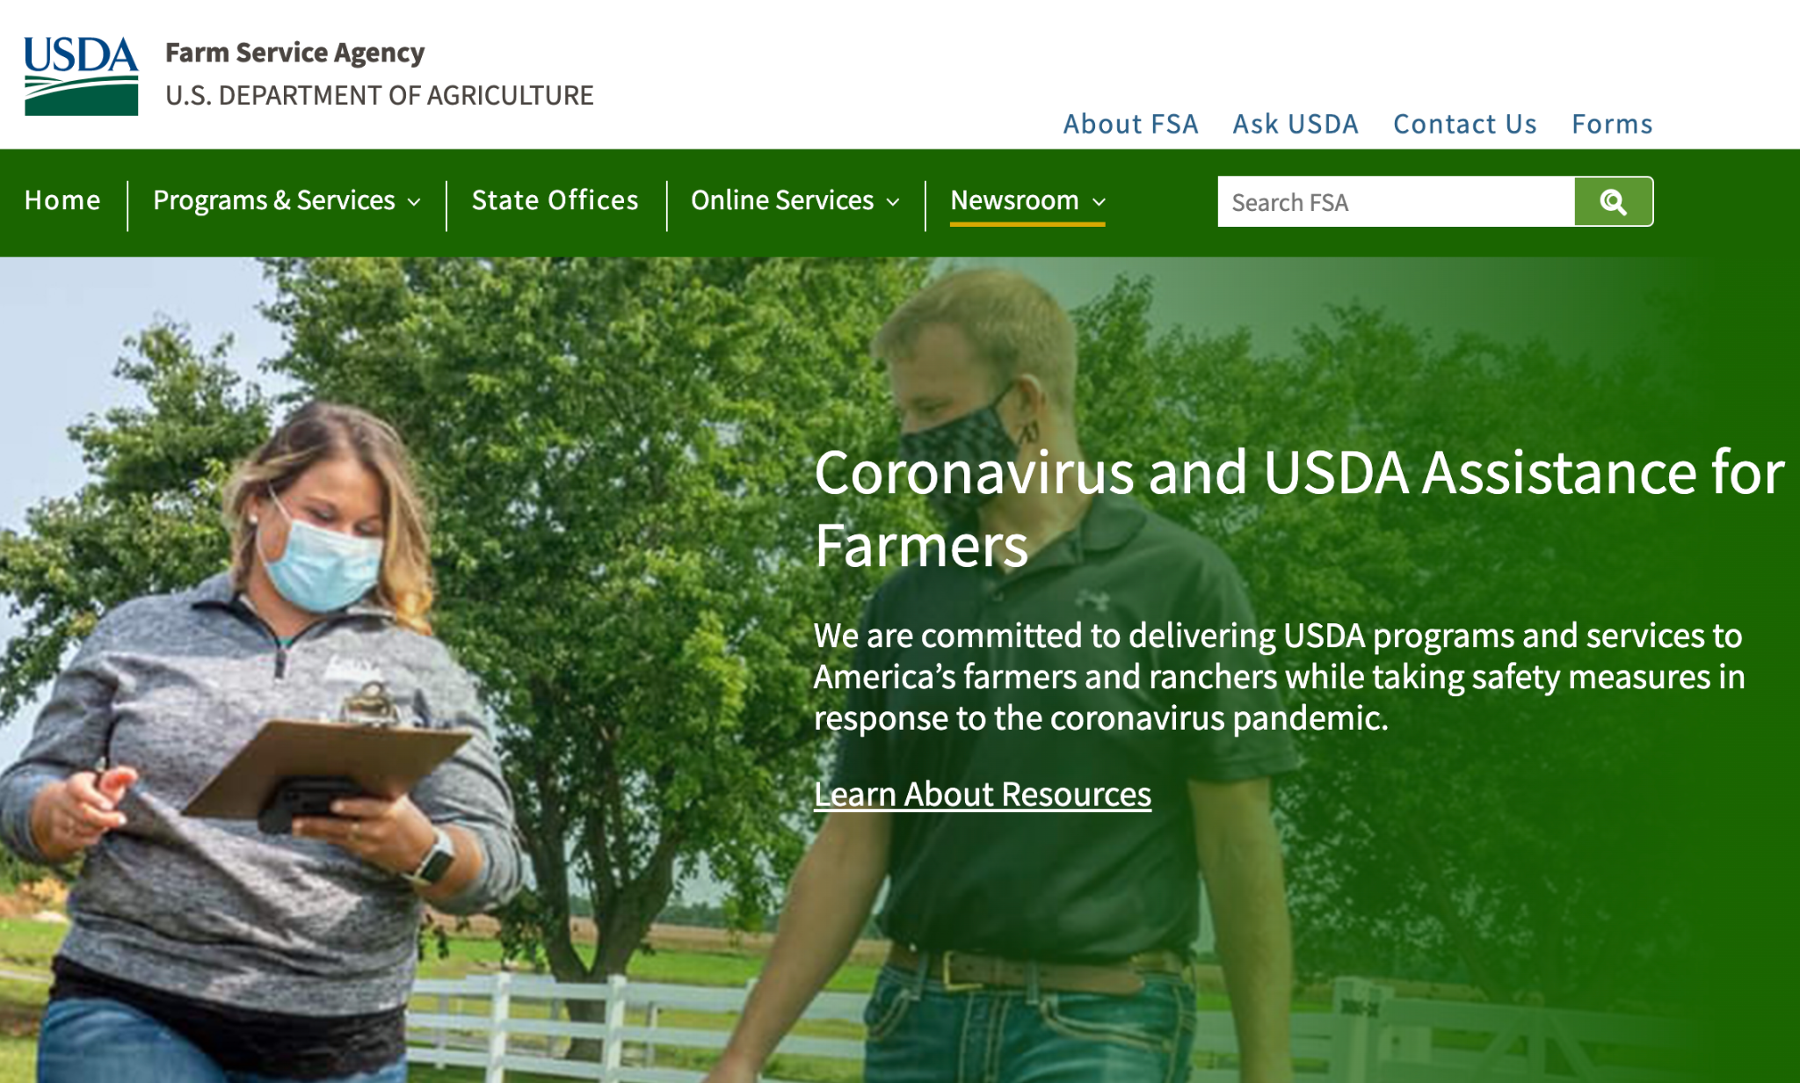
Finding Farms & Agribusinesses: USDA Farm
Service Agencies
USDA Farms Service Agency
The USDA farms service agency tracks agricultural data across the country and provides farmers with useful information. They work closely with farmers to ensure that crops grow healthy.
The Farms Service Agency can give you great insight into the issues most important to your local farmers/agribusinesses.
https://www.fsa.usda.gov/

Slide 20
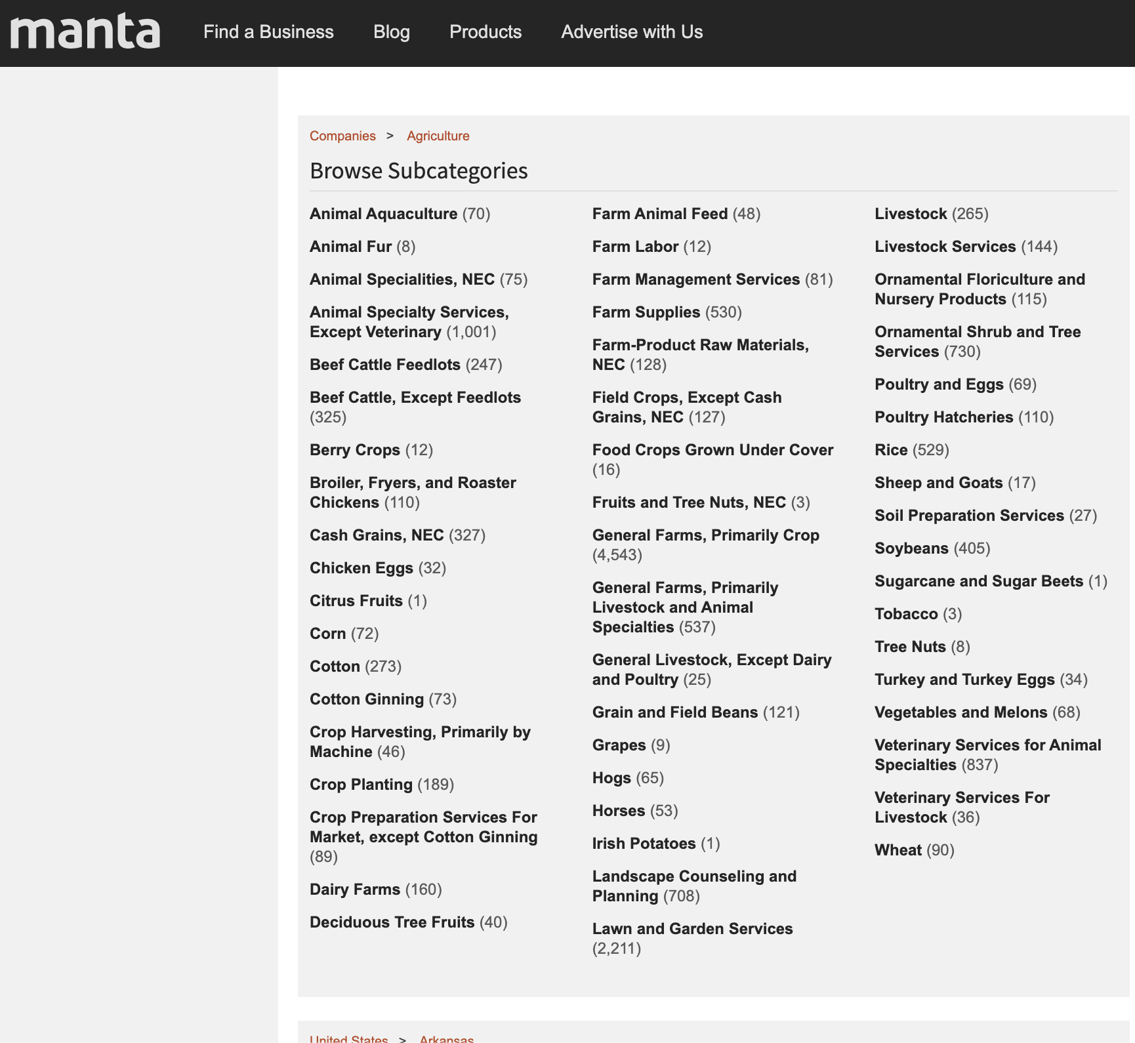
Finding Farms & Agribusineses: Manta.com
Manta.com is a national directory of local business. You can search Manta.com to find farms, dairies, and more in your area.
Manta.com lists information that will help you find the businesses most likely to hire migrant workers:
Address
contact information of the business
Number of Employees
Total annual revenue
https://www.manta.com/

Slide 21
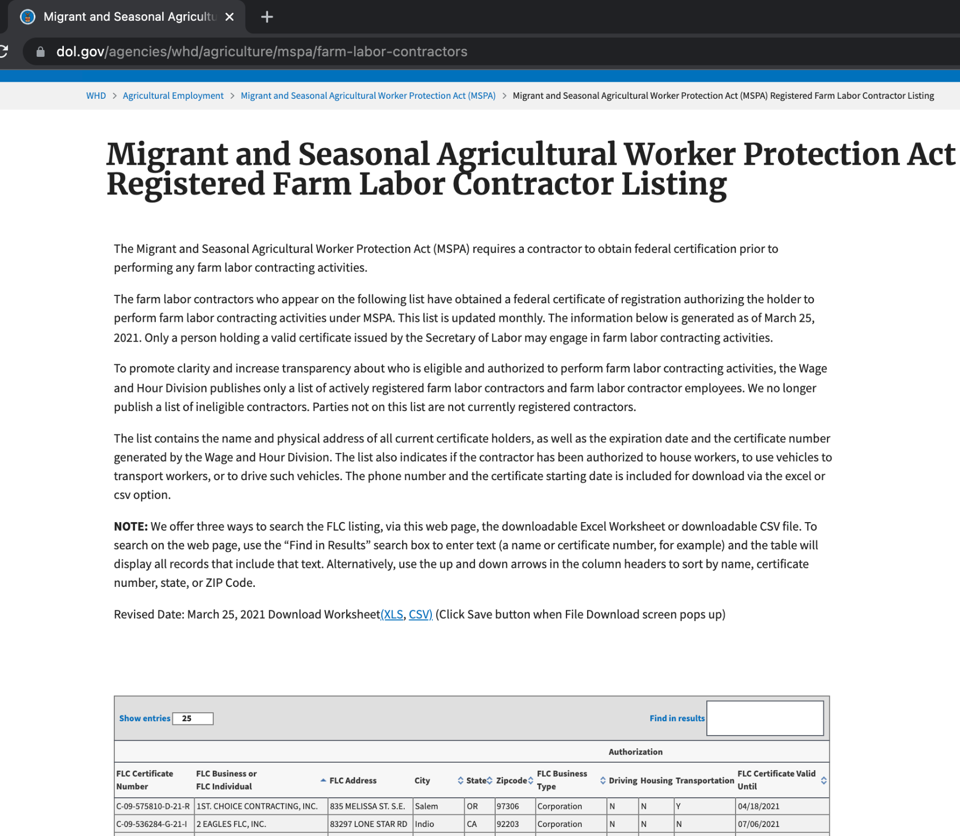
Finding Farms & Agribusinesses: Foreign
Labor Contractors
Contractors who hire foreign and seasonal help are required to be certified by the Department of Labor.
The Department of Labor maintains a database of all certified Foreign Labor Contractors that you can use to find the contractors in your area. The database includes addresses and phone numbers so you can contact them easily!
https://www.dol.gov/agencies/whd/agriculture/
mspa/farm-labor-contractors

Slide 22
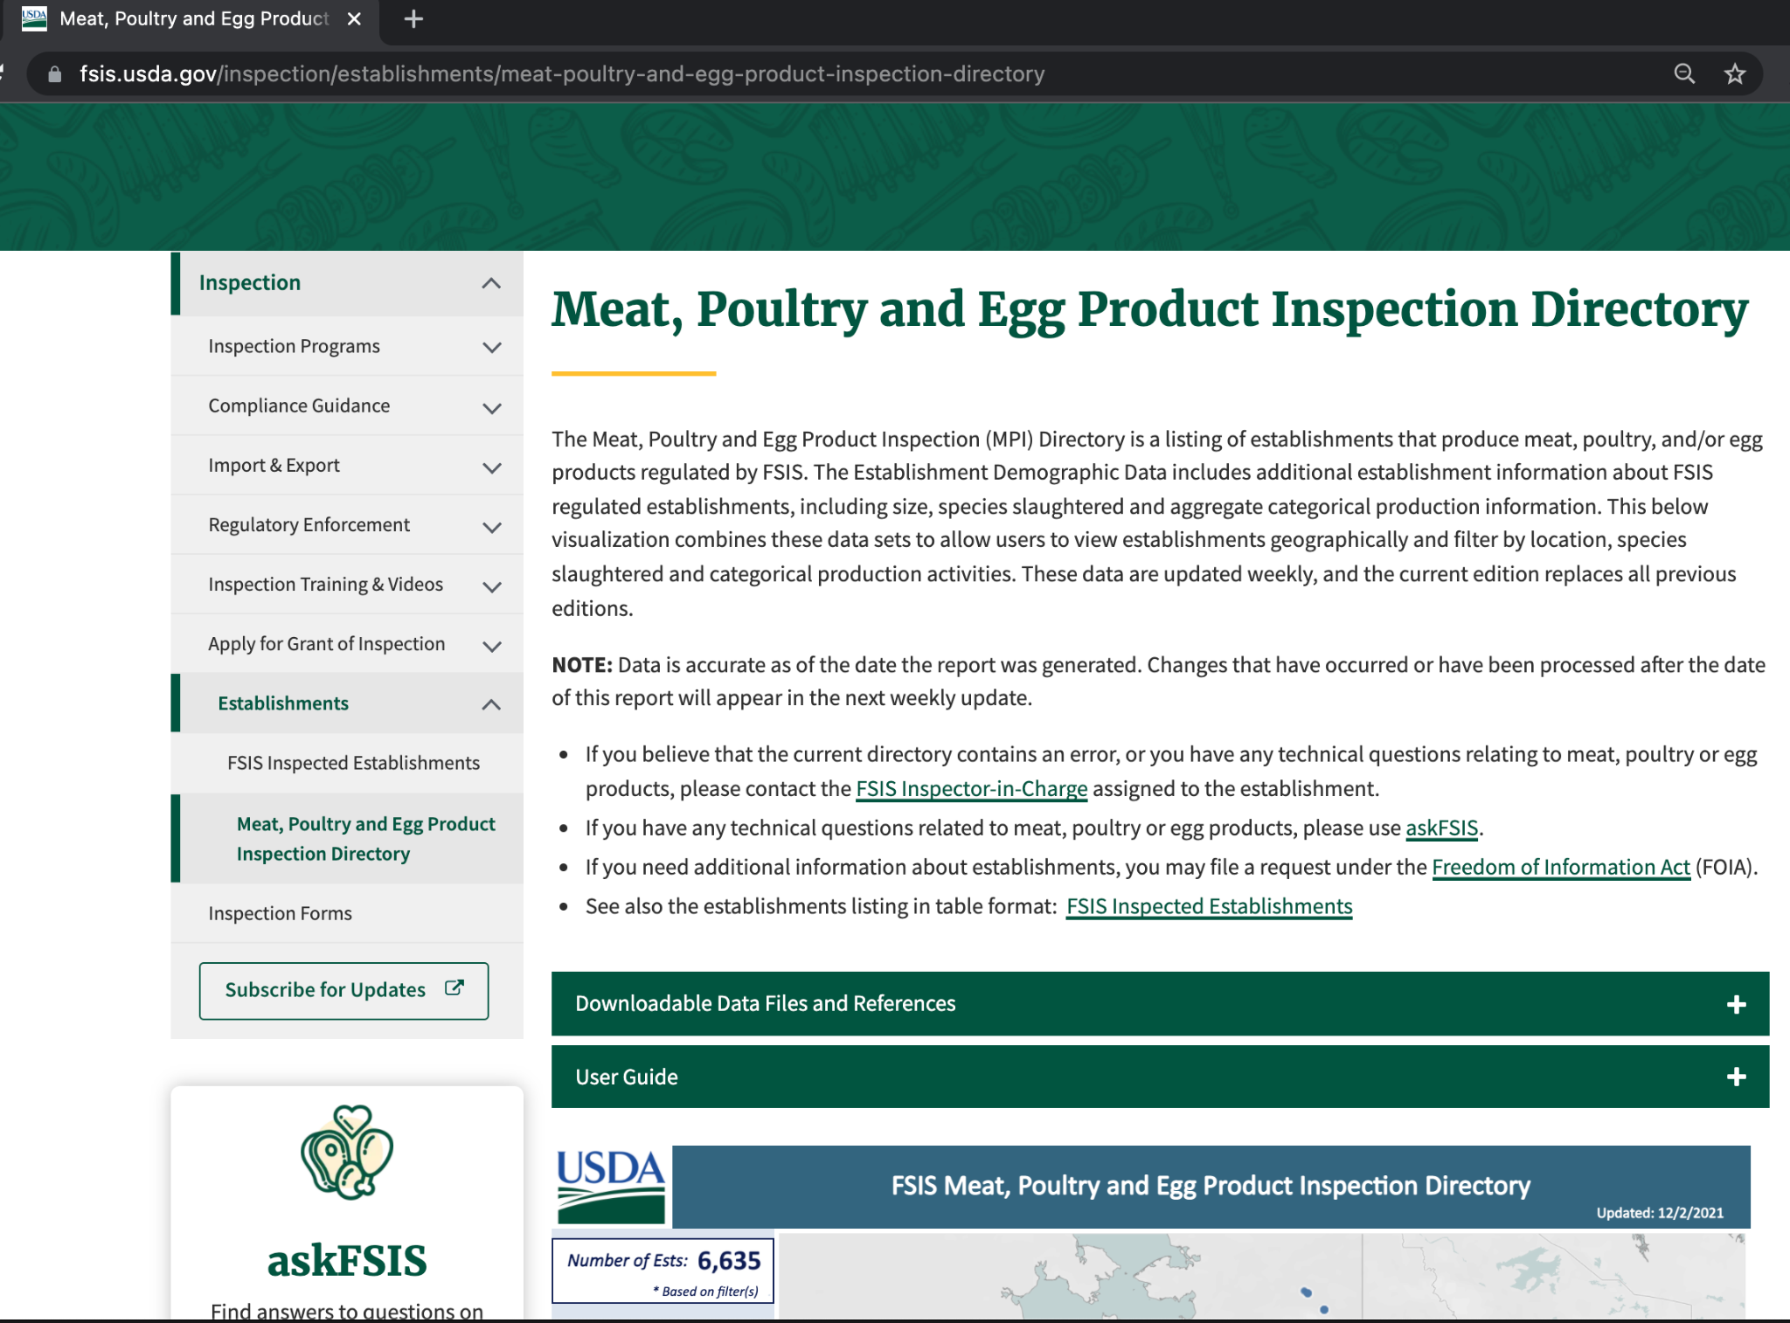
Finding Farms & Agribusinesses: USDA Meat, Egg, Poultry Processors
The USDA hosts a directory of all meat, egg, and poultry processors that have undergone inspection.
Use the directory and included map to find the processors in your area and start recruiting temporary workers who may qualify.
(This list is also linked in on the IDRC Agriculture Portal for your state.)
https://www.fsis.usda.gov/inspection/establishments/meat-poultry-and-egg-product-inspection-directory

Slide 23
Research: The Most Common Mistake
One of the most common mistakes that recruiters make while conducting research into farms and agribusinesses is to believe an address may be wrong because the address leads to a house or neighborhood.
A lot of farm or agribusinesses owners place their home address as the farm address. Don't make assumptions that just because the address is residential it does not have anything to do with the agribusiness in question.
Notes:
EDW: I like this “most common mistake” section

Slide 24
Prioritizing Farms in Your Area
Recruiters should establish and maintain a plan based on the evidence you have collected.
After systematically visiting the farms on your list, use good criteria to plan how often you should visit to help you plan your visits month to month.
Criteria could include:
Seasonal vs Temporary; and what season?
Anecdotal information about turnover
Number of workers/size of operation
Wages paid & quality of housing & other factors that promote stability or workforce turnover

Slide 25
Prioritizing Farms in Your Area
To established required frequency of visit, in your spreadsheet mark if you believe the farm should be visited:
Weekly
Bi-weekly
Monthly
Every three months
Every six months
Once a year

Slide 26
Establishing a Plan
In addition to frequency of visits, you should consider other factors when building your plan:
What is in season or what work is being performed now? Geography
Direct referrals made by schools, other recruiters, allies
Quantity of workers
Safety of location (is this a visit for a single recruiter or a team?)
Having a well thought out plan to visit the agribusinesses in your area is important because the more regularly you visit the farms in your recruitment area, the easier it will be to build relationships with the stakeholders on the farm.

Slide 27
Establishing a Plan
To begin creating your plan, you should look at the required frequency of visit you established for each farm and when the farm's crops are in season.
Go to your calendar and mark what farms you would like to visit each month. If some farms require more frequent visits, you can mark down what farms you would like to visit each week.
Keep track of the new data you collect in case you should visit more, or less frequently, and when.

Slide 28
When Should You Visit
In order to determine when you should visit, some of the first questions you should always ask an agribusiness include:
What time does the work day begin and end?
When are shift changes?
When do employees go on lunch?
When would be the best time to speak to someone?
It is important to respect the time of those who are working at the farm/agribusiness and make sure you are not interfering with the work that is being done.

Slide 29
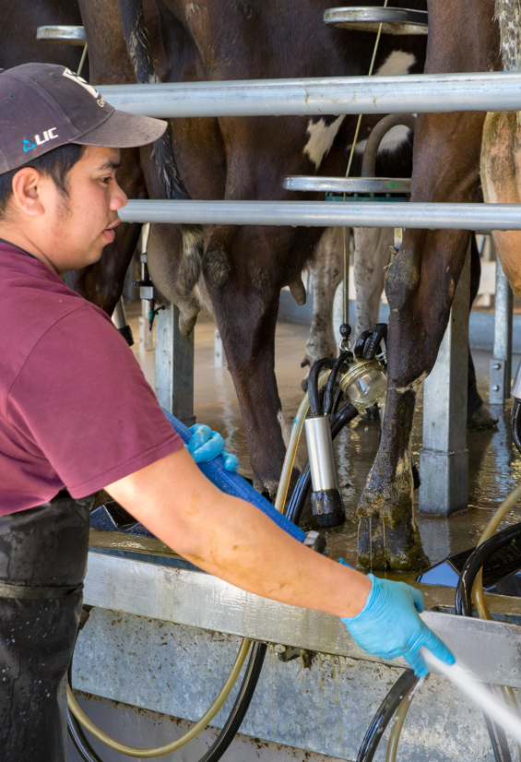
When Should You Visit?
Remember that when we most need to speak to agribusinesses is when they are also the busiest.
You can call ahead to the agribusiness or email the agribusiness to let them know you will be visiting or to make an appointment.
Visiting agribusinesses during the off season, when they are not as busy, gives you an opportunity to have longer conversations with the owners and supervisors. You can use the off season to build up trust and a strong relationship that can open doors during peak season.

Slide 30
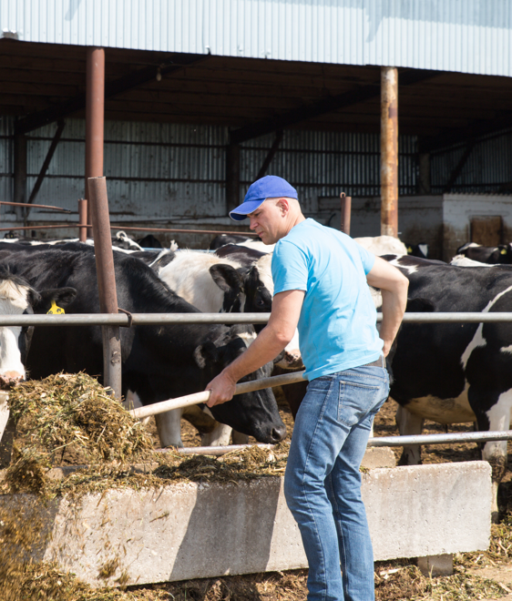
Identifying Who You Should Talk To
Think ahead of time about who you need to speak to and who could be the strategic person in the business that can open doors for you.
For a lot of businesses it could be the owner or a manager. As mentioned earlier, at other businesses it is the Human Resources director who can open doors and guide you.
Notes:
EDW: maybe add something about crew leaders or contratistas?

Slide 31
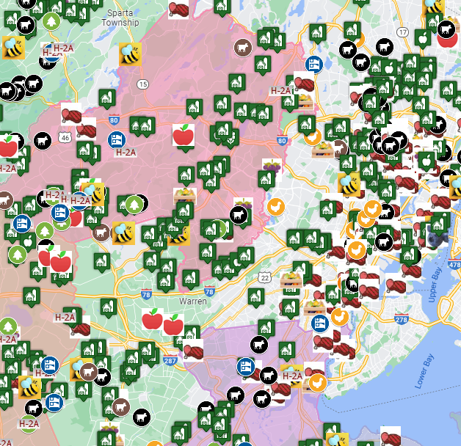
Planning Field Visits
A list of farms, forestry, fishing and agribusiness helps to plan efficient and effective field days. Farms can be grouped together by:
Geography - Businesses in the same town, or on the same road
Last date visited - Are there businesses you haven’t visited in a while?
Turnover - Have you heard that some workers moved? Time to visit to see if new workers are MEP eligible.
Seasons - Is it planting time, or time to detassel or stake? Is the harvest upon us?
High use - does production increase near holidays?

Slide 32
Identifying the Farm's Needs
To get buy in from farm owners and management, you have to demonstrate how the Migrant Education Program can positively impact or meet the needs of the farm workers.
Before visiting any farm, think about what the needs of the farm owner and farm workers could be. Then try to imagine how MEP and the services offered in your area can meet those needs.

Slide 33
Identifying the
Farm's Needs
Possible needs of farm owners/farm workers include:
Do workers have knowledge about available local resources?
Do workers need help learning English?
Are the workers interested in obtaining a GED or learning other materials?
Are workers struggling to come to work because of a lack of child care?
Does the farm need help translating training materials?
Does the farm workers need covid-19 safety materials?

Slide 34
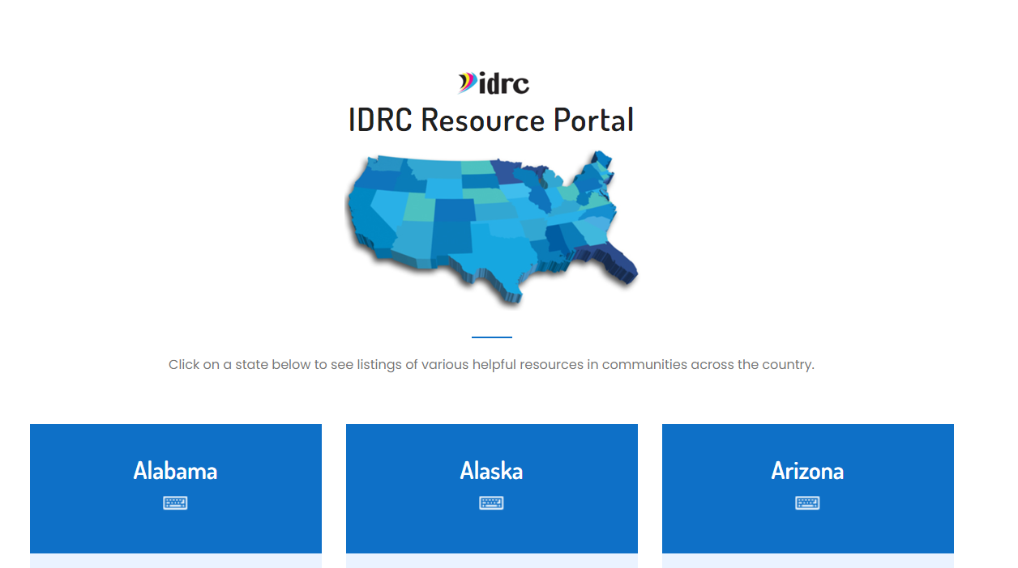
Identifying the Farm's Needs
Some ways MEP can meet the needs of the farmers include:
You can provide list of available resources in the area including food banks, medical services, head start programs, and other child care services.
You can provide free English learning materials
You can provide in person or virtual teaching services to help with anyone interested in obtaining a GED
If your state allows, you can help translate training materials or help participate in trainings in partnership with local agricultural agencies
You can provide masks and other materials to help them with COVID-19 safety
https://www.idr-consortium.net/portal/ResourcePortal.html

Slide 35
Building Trust & Relationships with Businesses
Know what you want to learn from your conversations. Some ideas that help with recruitment include;
What the jobs being performed here?
Who performs those jobs? Do workers tend to be locals who never move, or do they hire people who move around for work?
Is the work seasonal? If not, how long to workers tend to stay on the job, and why?
How many people do they employ?
Do they provide housing for workers?
When is a good time to meet up with workers to explain MEP and interview them?
What is the best contact information and address for this location, and any other related job-sites or housing.
Can you speak with people while they work or is that not permitted.

Slide 36
Building Relationships with Owners
When making contact, be persistent in your efforts and always follow up. If you are able to speak to someone at the farm, follow up with them after a few days via phone or email to thank them for their time.
If for some reason you are struggling with who you are speaking to, you may have to go above them or below them in the chain of command. It can often be helpful having someone lower in the chain of command to introduce you to someone higher up.

Slide 37
Building Trust & Relationships With Workers
When we look for eligible workers at their job, it’s important to establish trust.
Make sure they know who you represent, and who you don’t. A name tag and a clear introduction can help dissuade suspicion.
Your elevator pitch should include how MEP can benefit them.
Watch body language and listen. If this isn’t a good time to talk, find out when and where you can meet them to continue the interview.
Be clear about confidentiality - and follow through. Do not accidentally share who is enrolled with owners/managers without explicit permission.
Follow through on what you promise - a visit at another time; books; to send a copy of the COE, etc.
Make sure MEP service providers follow through after enrollment is complete.

Slide 38
Engaging Farm Workers
Employees at agribusiness will only engage with you if you engage with them first. Do not be nervous to say hello and start conversations.
Always keep a smile and remain positive and stay focused on your objective, no matter how anyone may try to distract you.
Always bring MEP that you can hand out or share such as bandanas, gloves, English materials, or resource guides.

Slide 39
Safety: De-Escalating the Situation
Occasionally, you will encounter someone in the field who responds negatively to you being there or to what you are saying.
It is important to know how to handle these situations. Prepare yourself ahead of time by thinking about how you would respond if someone responded aggressively to you.

Slide 40
Safety: De-Escalating the Situation
Remember that you are rarely the issue. Working on a farm can often involve long hours and can be very stressful. If someone is responding aggressively or negatively to what you are doing, it is likely because of other stress factors they are experiencing.
Take deep breaths, remain calm, and try to respond positively. Do not return the aggression or negativity.

Slide 41
Safety: De-Escalating the Situation
You are allowed to leave any conversation at anytime. If someone is responding negatively and you do not believe the conversation can be salvaged then it is best to leave.
Always have an exit plan no matter where you go and when you leave, move on from the situation.
When you get home, evaluate the situation, analyze what happened, and plan for new communication strategies that can help you avoid similar situations or de-escalate them in the future.

Slide 42
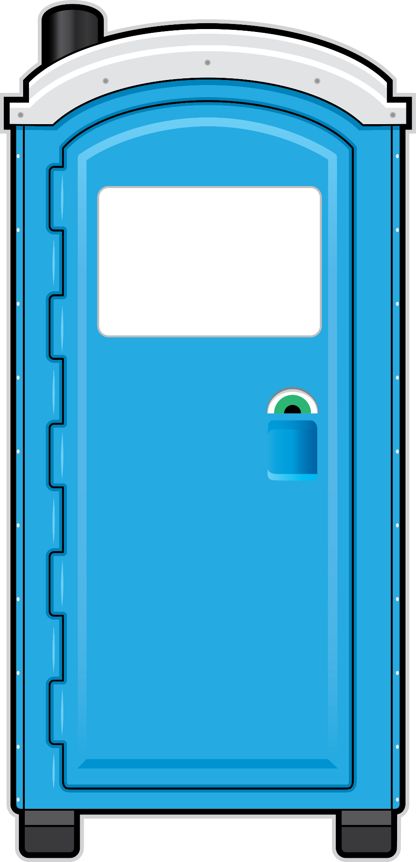
Other Outreach Methods
Besides speaking directly to farm owner and workers there are many other methods you can use to reach out to the employees at an agribusiness.
For example:
Put fliers on cars
Have a self referral form they fill out when applying, or when hired
Use the referral tool, or your state’s employment survey, in school registration plackets.
Hang materials about the program in high traffic area including break rooms, bathrooms, and even porta potties in the field
Get an actual name/s of a possible eligible person/s
Have link of the referral tool sent to possible interested employees
Insert
Flyer
Here

Slide 43
The Electronic Survey Tool
One free tool available to help you receive referrals from agribusinesses in your areas is the IDRC Electronic Survey Tool. The IDRC Electronic Survey tool helps to extend your reach in your community by allowing school districts, agribusinesses, community partners, currently enrolled families, and more to send in referrals for students that might potentially qualify.
https://idrreferrals.net/index.php

Slide 44
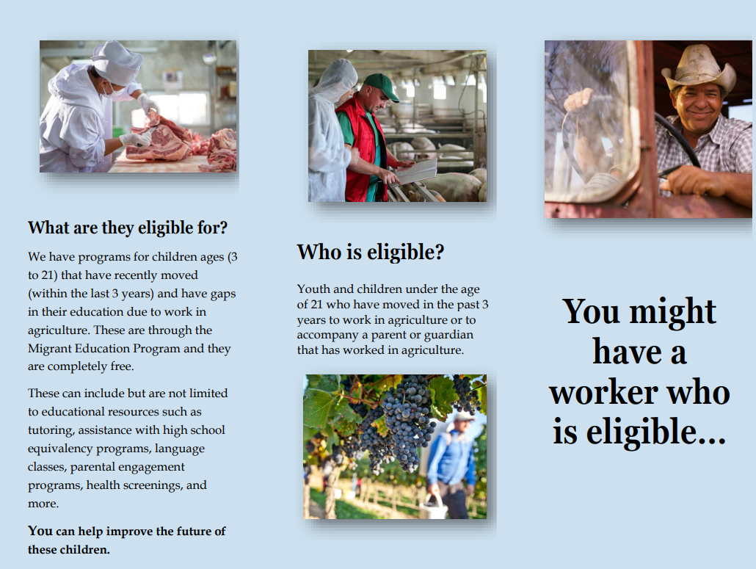
Using The Electronic Survey Tool
Create flyers to advertise local MEP services and include the QR code to access the Electronic Survey Tool.
Provide the QR code to local agribusinesses and encourage new employees to fill out the Electronic Survey Tool during orientation.

Slide 45
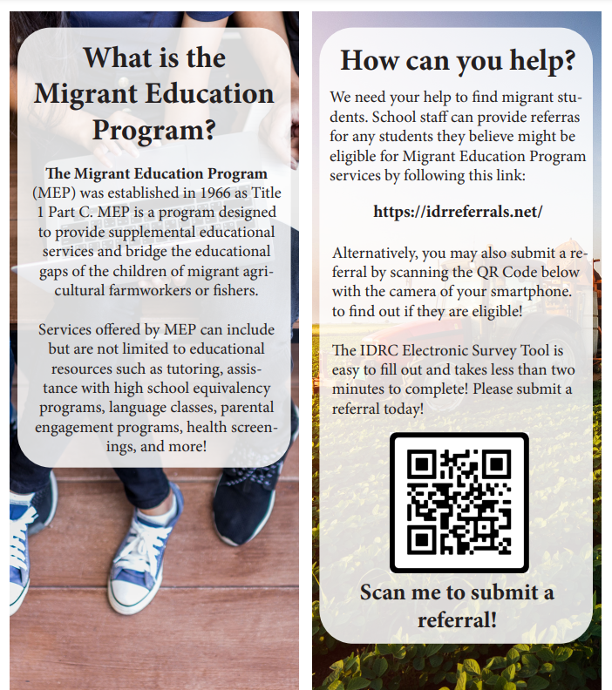
Using The Electronic Survey Tool
Provide business cards with the QR code to families already enrolled in the program so that they can refer families
Share the Electronic Survey Tool with local migrant health services, migrant head start, food banks, or other community organizations that might work with families who have previously performed work in agriculture.

